Slide 1

AGE AND GENDER DETECTION
CLASSIFICATION
BY – Kunal Malik
Roll no -2021812
SUPERVISOR – Mr. Sanjay Roka

Slide 2
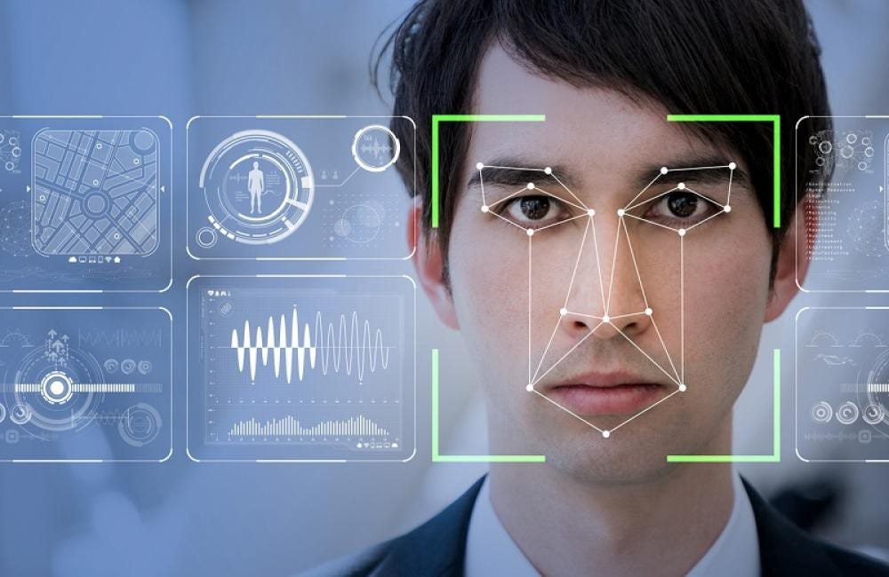
PURPOSE
The project focuses on detecting age and gender from facial images using deep learning
Importance of age and gender detection in various applications such as security , marketing and social media.

Slide 3
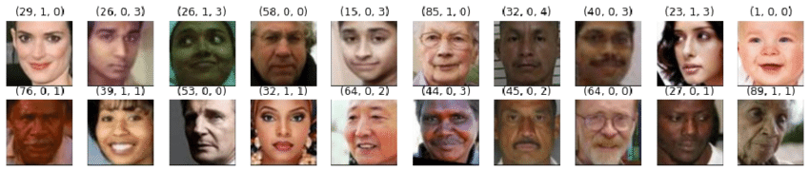
PROBLEM STATEMENT
SAMPLE
FROM
UTKFace
DATASET
Existing methods for age and gender detection often lacks accuracy due to diverse image conditions
The need for a robust system that can handle variations in facial expressions , lighting and pose.
Aim to built a CNN model that improves detection accuracy .

Slide 4
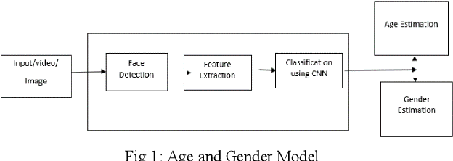
Data Loading: Mounted Google Drive to access the UTKce dataset.
Unzipping Dataset: Extracted the dataset for processing.
Image Processing: Loaded images in grayscale, resized to 128x128 pixels, and normalized pixel values.
Image Suggestion: Flowchart of the data preprocessing steps.
METHODOLOGY(DATA PRE-PROCESSING)
DATA LOADING – Mounted google drive to access the UTKFace Dataset
UNZIPPING DATASET – Extracting the data from dataset
IMAGE PROCESSING – Loading images in grayscale , and resize to 128X128 px

Slide 5
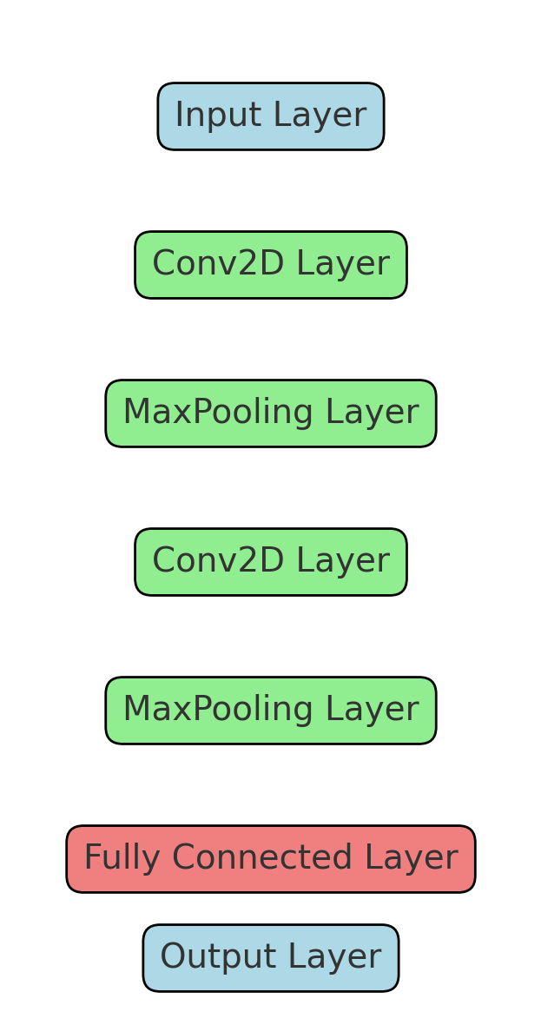
MODEL CONSTRUCTION
Construct a CNN model with multiple convolution and pooling layers
Used dropout layers to prevent overfitting
Two output layers for gender classification and age regression

Slide 6

TRAINING AND VALIDATION
Compiled the model with binary cross entropy for Gender and mean absolute error(MAE) for age.
Training was conducted over 50 epochs with a validation split of 20 %.

Slide 7
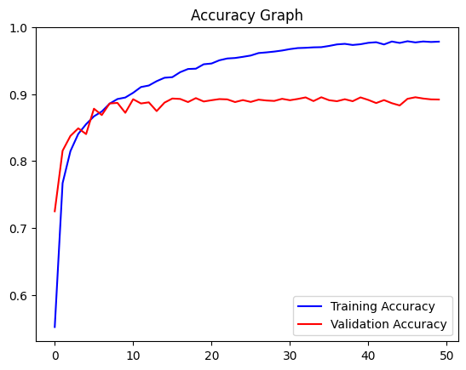
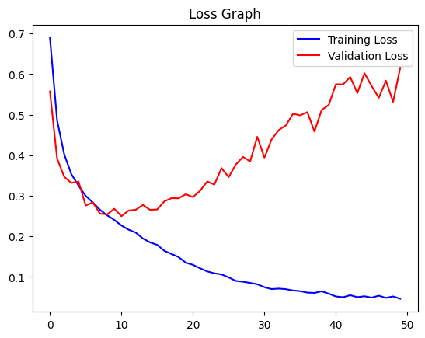
RESULTS – GENDER CLASSIFICATION
Achieved high accuracy in gender classification
Training and validation accuracy plotted over epochs
Training and validation loss plotted over epochs

Slide 8
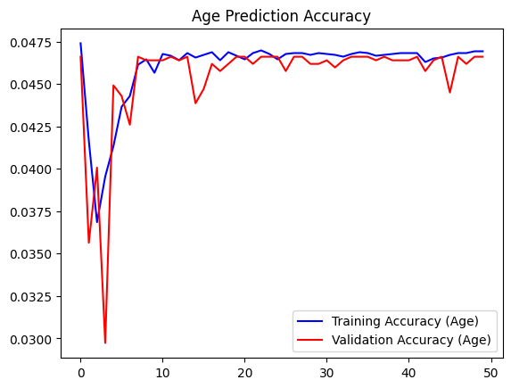
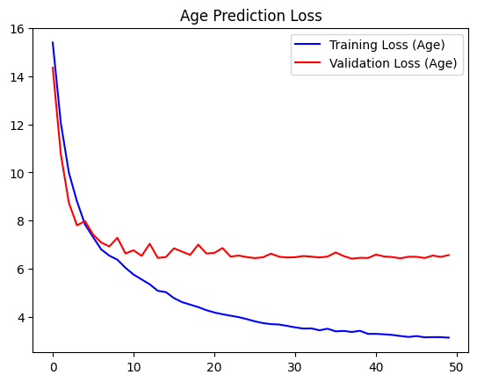
RESULTS – AGE CLASSIFICATION
Model effectively predicted age with reasonable accuracy
Training and validation accuracy plotted over epochs
Training and validation loss plotted over epochs

Slide 9
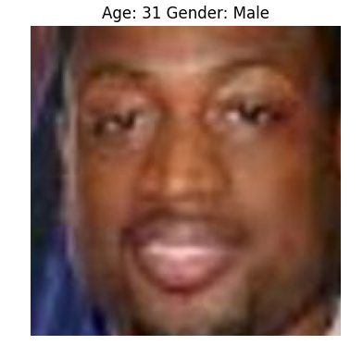
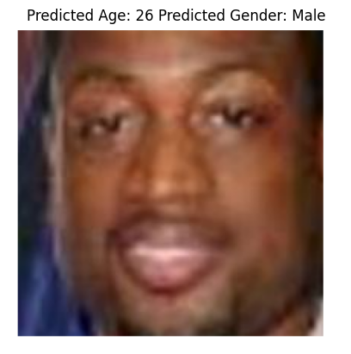
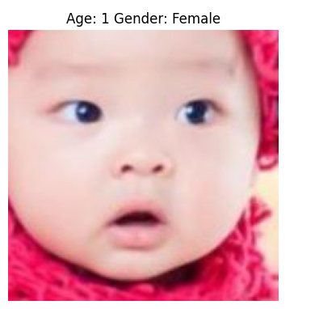
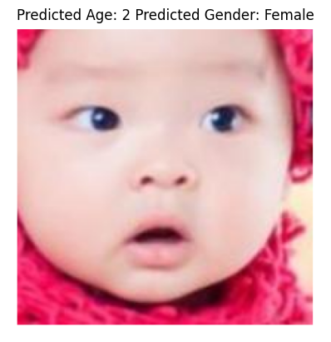
RESULTS – SAMPLE PREDICTIONS
Input
Output
Input
Output
Comparison with sample images and results
Model effectively predicted age and gender with reasonable accuracy

Slide 10

CONCLUSION AND FUTURE WORK
Successfully built a CNN model for age and gender detection with good performance
Highlighted the robustness of the model against variations in facial images
Future work includes enhancing model accuracy testing on more diverse dataset and exploring additional features

Slide 11
THANK YOU

